Slide 1
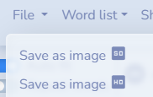



Word Cloud/Map
WordClouds.com
Free Word Cloud Generator – MonkeyLearn
Word Cloud Generator
Right-click on an image, then select “Replace image,” then select “Upload from computer” to replace the image with the word cloud image saved on your device.
If your saved image file is in SVG format, you will need to convert it to PNG or JPG format. You can do so by using this site: SVG to PNG

